Slide 1


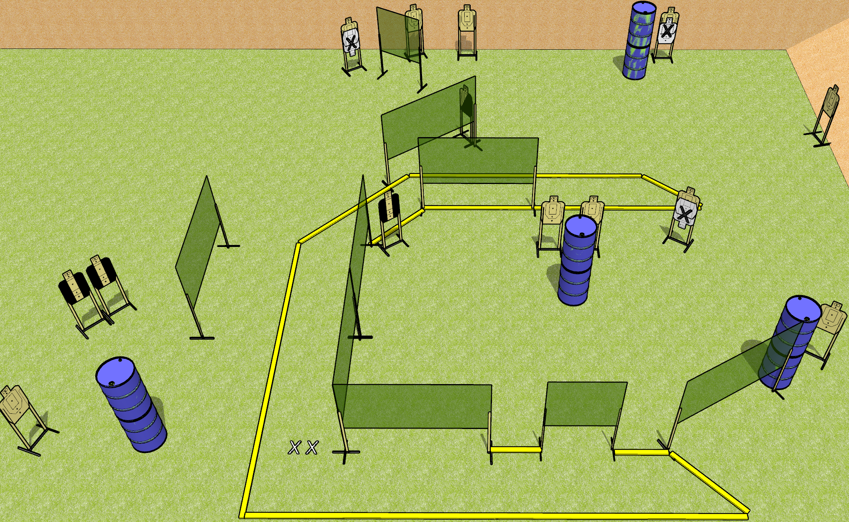
 | Dothan Gun Club – USPSA Match Flexing Course Designer : Drew Coleman
START POSITION : Standing with both feet on X’s, wrists below belt
GUN READY CONDITION : Pistol unloaded and holstered. PCC unloaded, held with both hands, shouldered, safety on |  | SCORING: Comstock, 28 rounds TARGETS: 14 paper, 0 Steel SCORED HITS: Best 2 on paper, steel until down START-STOP: Audible, last shot RULES:
STAGE PROCEDURE: Engage targets as they become available from within the fault lines.

Slide 2
Flexing
Written Stage Briefing
Flexing is a 28 round, 140 point, Comstock field course. There are fourteen USPSA targets. The best two hits on paper will score. The start signal is audible.
Handgun start position is standing with both feet on X’s, wrists below belt. Handgun is unloaded and holstered.
PCC start position is standing with both feet on X’s. Unloaded carbine is held with both hands, shouldered, safety on.
On start signal, engage targets as they become available from within the shooting area.

